Slide 1

CLOUD INFRASTRUCTURE NETWORK SECURITY
INFO 7350 - Systems and Cybersecurity Fundamentals Spring 2021
Guided By:
Prof. Angel L. Hueca
Northeastern University
TEAM - 1
Hemant Jain Mahesh Vatalu Renukaprasad
Sapna Patel
Krutarth Vanesa
Vivek Shakya
Notes:
Hemant

Slide 2
Table of Contents
INFO 7350 - Systems and Cybersecurity Fundamentals Spring 2021
Cloud Computing
Cloud Security - Why?
Understanding the problems
Research Problem and Statement
Identity and Access Management
IaC - Infrastructure as Code
Shared Responsibility Model
Materials and Methods
Results
Conclusion
Notes:
Hemant

Slide 3

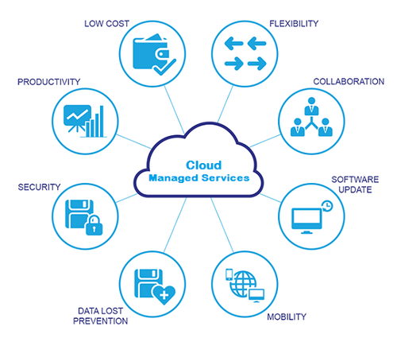
Cloud Computing
Notes:
Hemant
What is cloud computing, in simple terms?
Cloud computing is the delivery of on-demand computing services -- from applications to storage and processing power -- typically over the internet and on a pay-as-you-go basis.
TOP CLOUD PROVIDERS
Top cloud providers: AWS, Microsoft Azure, and Google Cloud, hybrid, SaaS players
How does cloud computing work?
Rather than owning their own computing infrastructure or data centers, companies can rent access to anything from applications to storage from a cloud service provider.
One benefit of using cloud computing services is that firms can avoid the upfront cost and complexity of owning and maintaining their own IT infrastructure, and instead simply pay for what they use, when they use it.
In turn, providers of cloud computing services can benefit from significant economies of scale by delivering the same services to a wide range of customers.

Slide 4
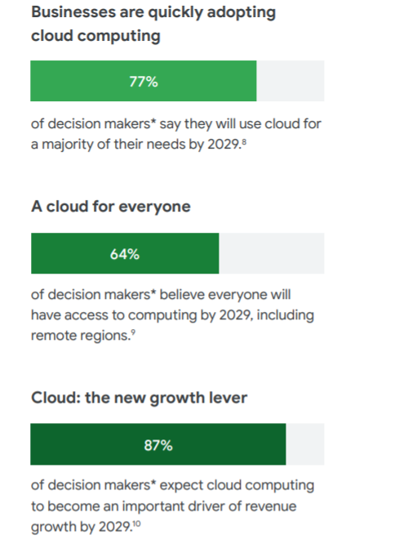
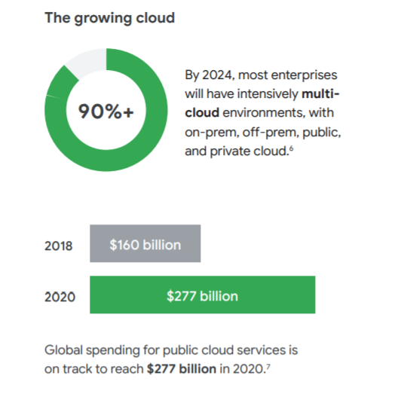
Cloud Security - Why?
Notes:
Hemant ---
Why – As we have noticed in lots of recent cybersecurity breaches, the attackers were successful because they were able to get access to cloud infrastructure. Once they penetrate the cloud, then they can carry out different kinds of attacks either by obstructing product functions or stealing the sensitive data.
Now-a-days the major challenge with the Cloud is how computing resources should be utilized as the main goal of it is to provide the change in the economics of the data center, but before migrating the sensitive and private data completely into the public cloud, issues of security standards and compatibility must be addressed and implementing out the various tech blockages and secure authentications to avoid the data loss and regulatory breaches.
Hence, we decided to research policies and methodologies – best practices and the tools that can help in making the cloud application secure. Some of the ways to make cloud applications secure is traffic control, using secure protocols, securing the cloud access secrets, implementing the data encryption techniques.

Slide 5
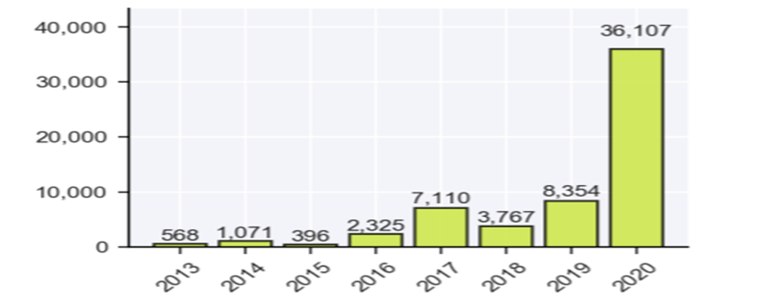
How pandemic change Cyber Security
In the first three quarter of 2020, 21% of reported breaches involved the use of ransomware.
These ransomware-related events contributed to the unusually high number of unknown (11.2%) and miscellaneous (10.4%) data types exposed.
Following well established trends, the Healthcare sector had the most reported breaches, accounting for 11.5% of the events that could be attributed to a specific economic sector.
Notes:
Hemant

Slide 6
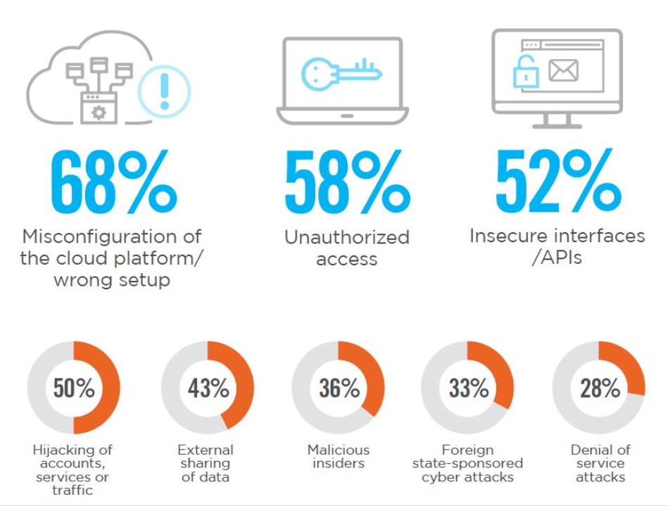
Understanding the problem
It inherits the security issues which persist in those individual platforms involving
Secure access
Authentication
Authorization
Access management
Security controls and services
Misconfigurations
Access Control Vulnerabilities
Data-theft and cross-control access
Notes:
Hemant

Slide 7

Project objective
The main objective of the research is to identify the most common issues that organizations consider when migrating their infrastructure from on premise to cloud and explore the security services and policies that can make the cloud infrastructure more secure and reduce the vulnerabilities at the architecture level.
Notes:
Hemant
The problems which it inherits from its multi-tenancy and agile work model are Misconfigurations, Shared tenancy vulnerabilities, meeting and billing evasions. One of the things which every organization needs to look up while building out or migrating their traditional infrastructure into the cloud would be the accessibility and ability to prevent data-theft and cross-control access.

Slide 8



Target audience
Organizations looking to migrate their infrastructure on cloud
Organizations looking to start their infrastructure on cloud
Developers interested in hosting applications on cloud
Notes:
Hemant

Slide 9
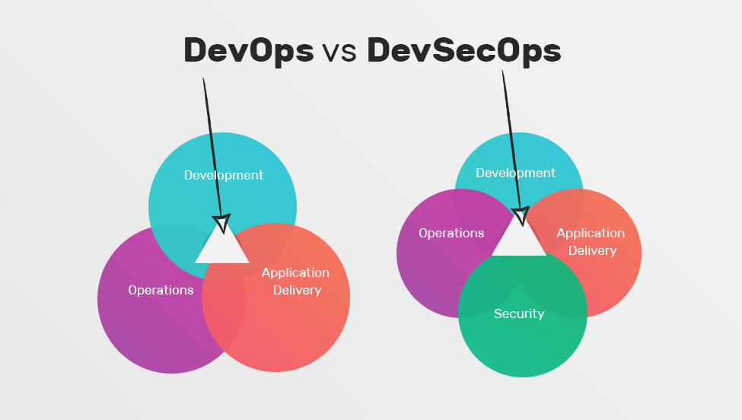
DevOps and DevSecOps
Notes:
Hemant
DevOps and DevSecOps methodologies share similar aspects, including the use of automation and continuous processes for establishing collaborative cycles of development. However, while DevOps prioritizes delivery speed, DevSecOps shifts security to the left.
Initially, DevSecOps practices may increase the development time but will ensure that the codebase is secure from its inception. After some practice, and once security is fully adopted into the development process, teams will gain the advantage of increasing their writing and delivery speed for secure codebases.

Slide 10
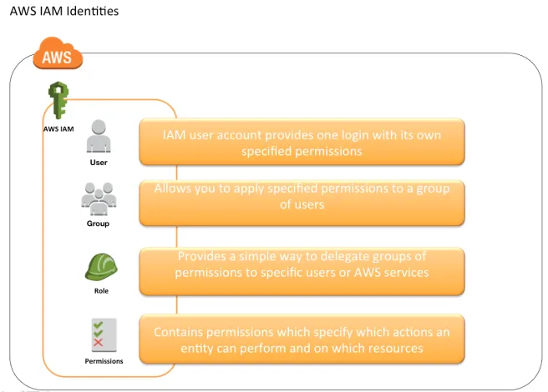
Identity, Access and Management (IAM)
Manage users, groups and roles
Create suitable roles for different cloud resources
Manage user permission by designing relevant IAM policies
Follow the principle of least privilege while assigning permissions or creating IAM policies
Can be integrated with your own user repository
Best practices to be followed for IAM credentials from security perspective
One IAM role per person
Never commit or share IAM credentials
Never use root credentials
Notes:
hemant

Slide 11
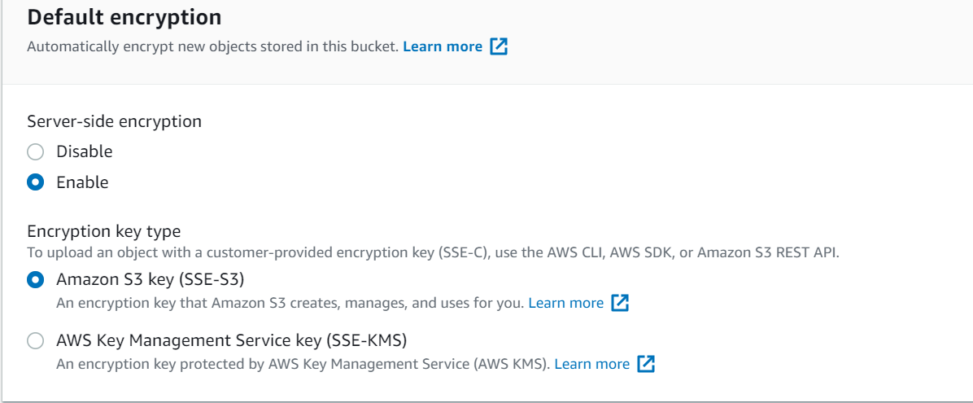
Encrypting Data at rest and in transit
Make use of the key management service to encrypt your data
Cloud providers offer key management which is completely managed by them or you can also use custom keys which are managed solely by the customer
The data keys used to encrypt your data are also encrypted and stored alongside the data that they protect
Notes:
hemant

Slide 12
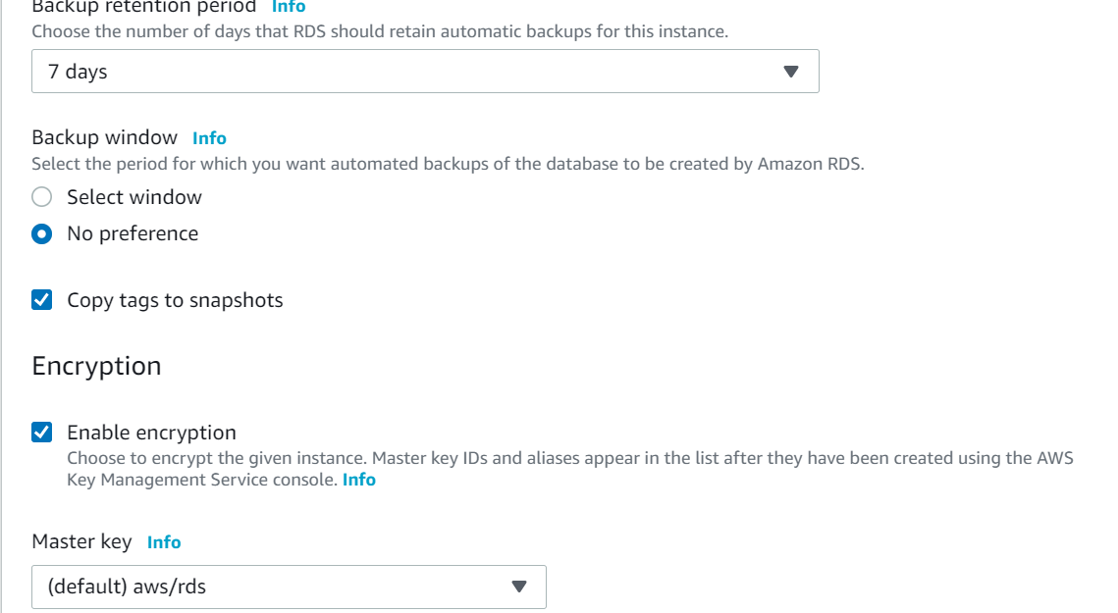
Encrypting data residing in a Relational database storage
Notes:
Hemant
Amazon RDS can encrypt your Amazon RDS DB instances. Data that is encrypted at rest includes the underlying storage for DB instances, its automated backups, read replicas, and snapshots.
Amazon RDS encrypted DB instances use the industry standard AES-256 encryption algorithm to encrypt your data on the server that hosts your Amazon RDS DB instances. After your data is encrypted, Amazon RDS handles authentication of access and decryption of your data transparently with a minimal impact on performance. You don't need to modify your database client applications to use encryption.

Slide 13
Methodology / Security Approach
Understand the design shift from on premise to cloud
Consider security as an architectural strategy
Control access privileges
Use a risk based approach
Focus on monitoring and logging
Notes:
Vivek

Slide 14
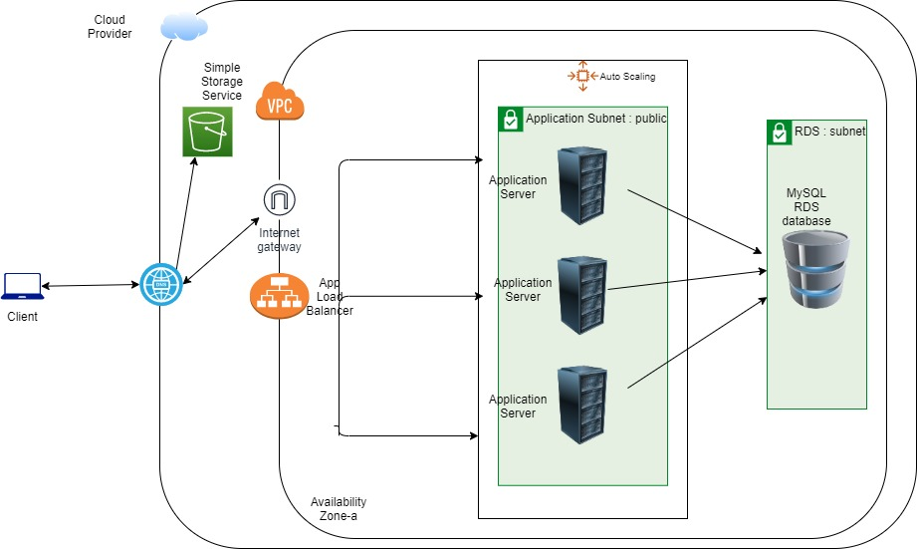
Model 1 - weak architecture design
Notes:
vivek

Slide 15
Cloud resources leveraged for model 1
VPC - isolate your cloud resources, need to assign a CIDR range
Public subnets - falls inside the CIDR range of the VPC CIDR
Web Servers - linux instance which host the web application
Relational Database server which serves the requests made from web servers
Default security groups which allows access to linux instances
Routing tables - stores route from web and database servers to the internet gateway
Internet gateway- allows access to public internet via DNS
DNS - domain name server which resolves the host names
Notes:
Vivek

Slide 16
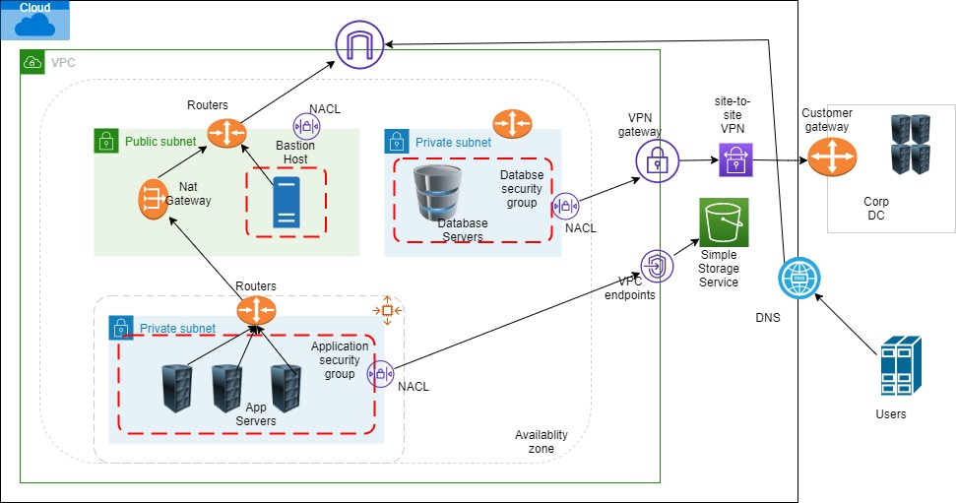
Model -2 showcasing security at architecture level
Notes:
vivek

Slide 17
Cloud resources leveraged for model 2
VPC - virtual network to isolate your cloud resources
Public subnets - host public instance and NAT gateways which in turn allow access to private instances
Private subnets - helps to enable a layered security approach by assigning private ip’s to your resources
NAT gateway - allows access to compute instances inside private subnets , must be placed in a public subnet
Security groups - enable access rules for specific protocols and their associated ports, stateful components
Network Access list - implements another layer of security placed before security groups, stateless components(need to specify inbound and outbound rules separately)
Notes:
Vivek

Slide 18
VPC/service endpoints - provides secure and direct connectivity to cloud resources, allows private IPs to reach the cloud resources
Site-to-site VPN - creates a secure connection between corp. data center or remote location to your cloud resources using IP Security (IPSec) tunnels
VPN gateway - sends encrypted traffic from cloud network to the on premise data center
Customer gateway - physical device that forms the part of the IPSec tunnel with VPN gateway when utilizing the site-to-site VPN connection
Notes:
Vivek

Slide 19
Why Infrastructure as Code and why we need to secure it?
These Infrastructure as Code scripts are can be identified beneficial with the example of Fortune 500 company Intercontinental Exchange (ICE).
ICE uses IaC scripts to maintain 75% of its 20,000 servers
These results in a time reduction of environment provisioning from one or two days to 21 minutes.
Defects in IaC scripts can have serious consequences, as these scripts are associated with setting up and managing cloud-system infrastructure and ensuring the availability of client side services.
For example, in early 2017, execution of a defective IaC script removed the home directories of around 270 customers in cloud instances maintained by Wikimedia.
Notes:
Krutarth

Slide 20
Best Practices to Secure IaC
Manual Security Assessment:
This step involves reviewing the architecture/templates before they are deployed and inspecting the live infrastructure after deployments.
Codify everything:
All of the infrastructure specifications should be coded in configuration files, such as AWS CloudFormation templates. Infrastructure should be deployed seamlessly, and no one should log into a server to manually make changes.
Notes:
Krutarth

Slide 21
Best Practices to Secure IaC (Continued)
Continuously test system, integrate and deploy: When changes are made automated tests verify that there were no security and compliance regressions before deploying the changes to a production server. All of this is managed by an automated CI/CD pipeline. Unit tests for configuration code should include security checks such as the following:
Disable unnecessary services.
Close unused ports.
Look for hardcoded credentials and secrets.
Check and review permissions on files and directories.
Ensure that development tools are not installed in production servers.
Check auditing and logging policies and configurations.
Notes:
Krutarth

Slide 22
Best Practices to Secure IaC (Continued)
Version everything:
The config files should be managed in a version control system. Because all configuration data are written in code, any modifications to the code can be controlled and tracked. Any changes in infrastructure will be performed by changes committed to the VCS. In addition, VCS is important for IaC because it provides the following functions:
Traceability: Record all changes that have been made.
Rollback: Restore things back in case of any failures.
Correlation: Useful for tracing and fixing complex problems when these occur.
Visibility: All team members can see when changes are committed to VCS.
Actionability: VCS can trigger actions automatically when a change is committed.
Notes:
Krutarth

Slide 23
Best Practices to Secure IaC (Continued)
Modular code (small changes rather than big batches):
Smaller changes make errors easier to detect and allow the team to fix them.
Easier and less effort in case of testing the changes and evaluation.
Faster to find the cause of the bugs and errors, then easy to fix them.
Immutable infrastructure:
IT infrastructure elements are replaced for each deployment, instead of making changes to current infrastructure. This process provides consistency, avoids bugs in previous infrastructure and restricts the impact of being breached. It improves security and makes fixes easier.
Notes:
Krutarth

Slide 24
Best Practices to Secure IaC (Continued)
Continuous security and service availability:
It's important to secure not only the application and its runtime environment but also the CI/CD pipeline and test environment.
It is important to protect the pipeline from attacks by ensuring that all changes are fully transparent and traceable from end to end.
Notes:
Krutarth

Slide 25
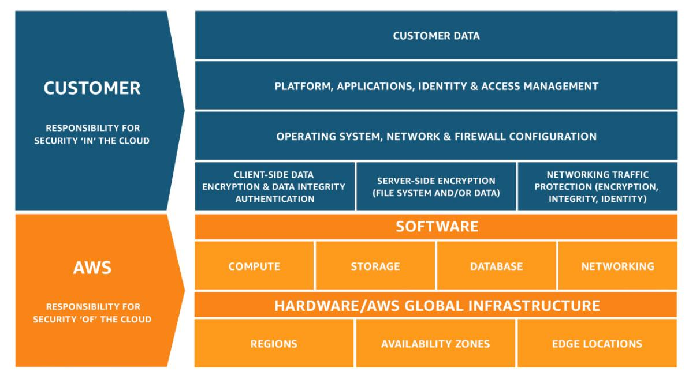
Shared Responsibility Model
Clients should use some of features present within cloud infrastructure to protect their resources like:
Security Groups
Private Subnets
CORS (Cross-Origin Resource Sharing)
Web ACLs
Firewalls
Encryption
Setting up roles, policies and users etc
Notes:
Mahesh

Slide 26
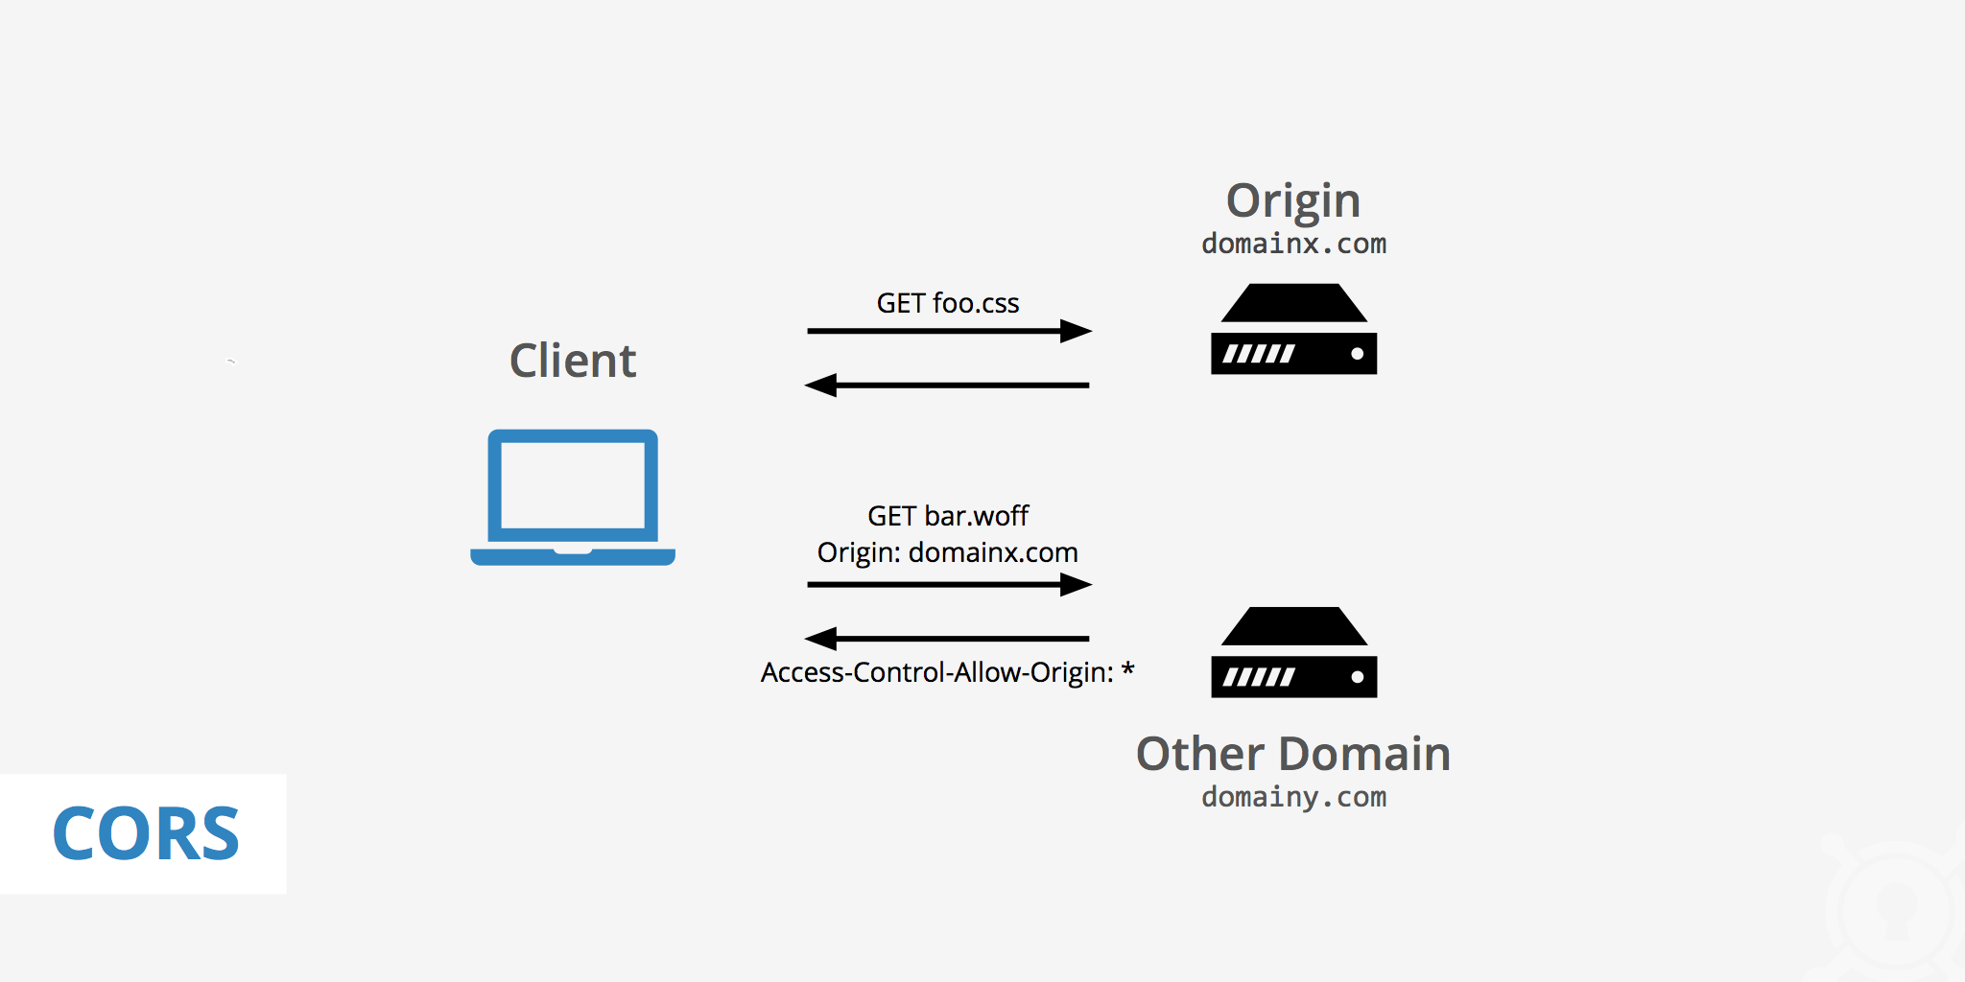
Securing your APIs
CORS (Cross-Origin Resource Sharing)
CORS is a mechanism that allows restricted resources on a web page to be requested from another domain outside the domain from which the first resource was served.
The benefit of CORS is that it allows your domain to allow reads from another trusted domain.
Notes:
Mahesh

Slide 27
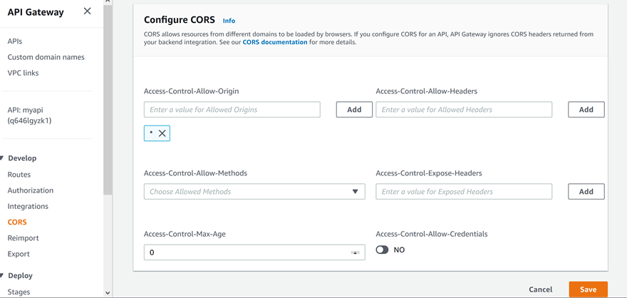
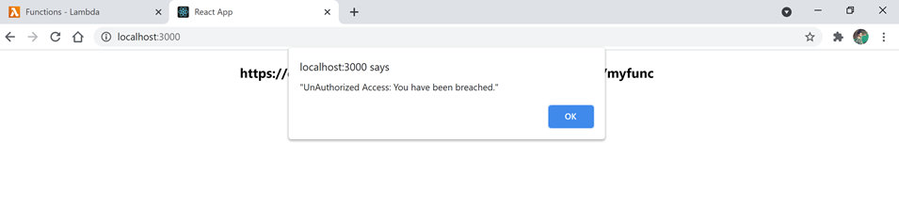
Configuring CORS in API Gateway in AWS
Misconfiguring CORS with “*” Value
Notes:
Mahesh

Slide 28
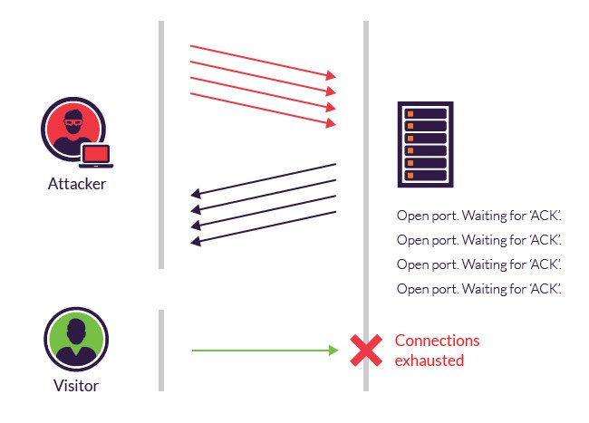
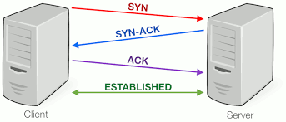
SYN Flood Attack
TCP HandShake
SYN Flood Attack
Notes:
Mahesh

Slide 29
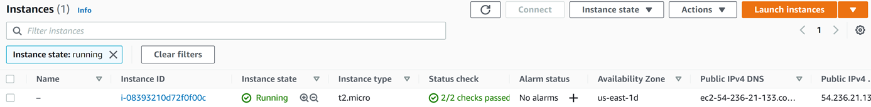
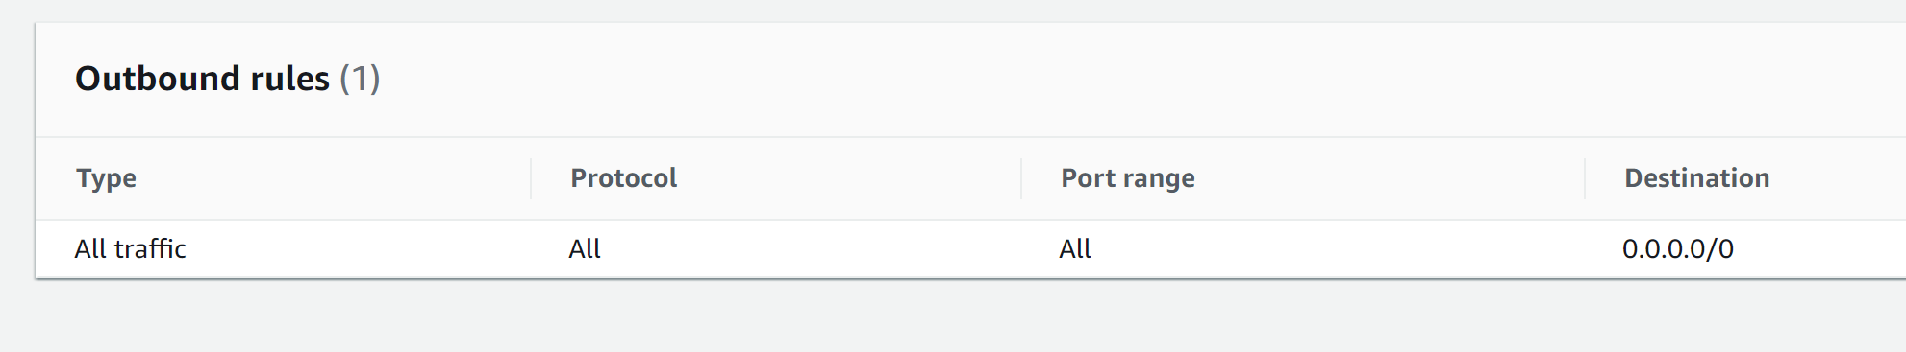
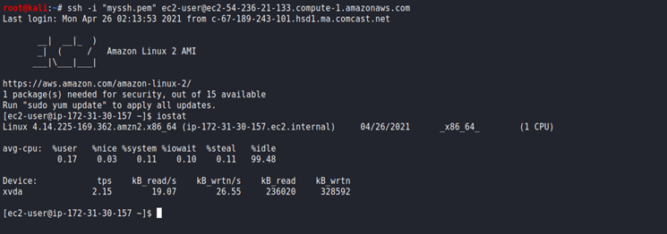
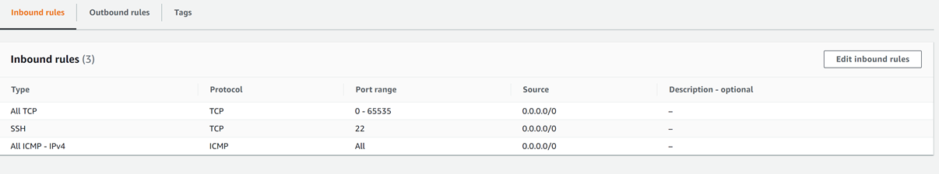
SYN Flood Attack using Metasploit
Notes:
Mahesh

Slide 30
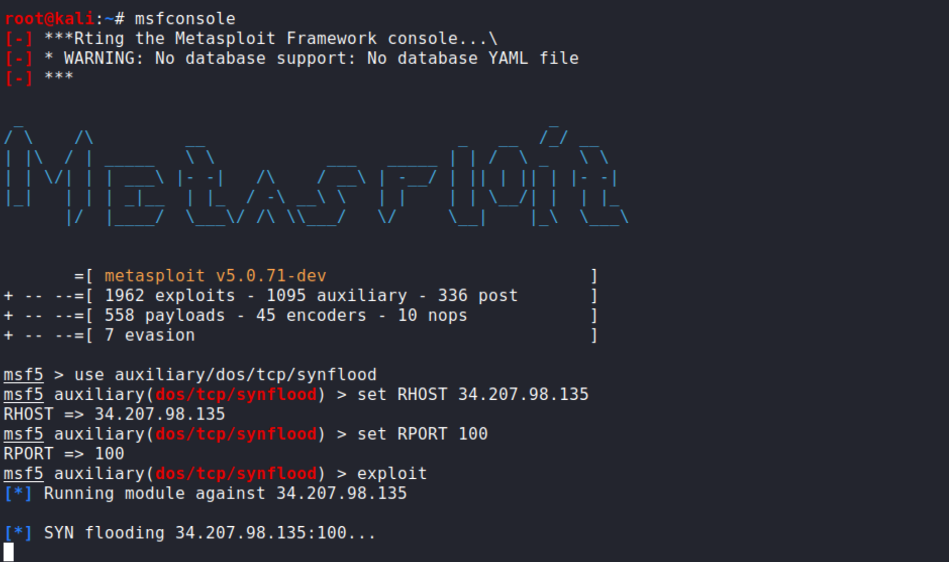
SYN Flood Attack (Continued...)
Notes:
mahesh

Slide 31
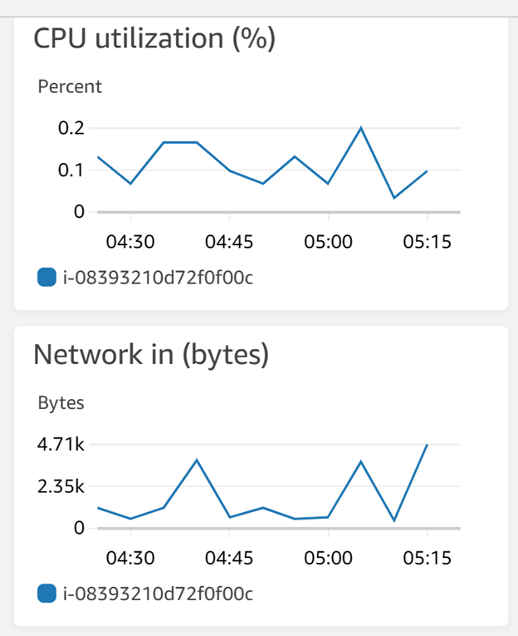
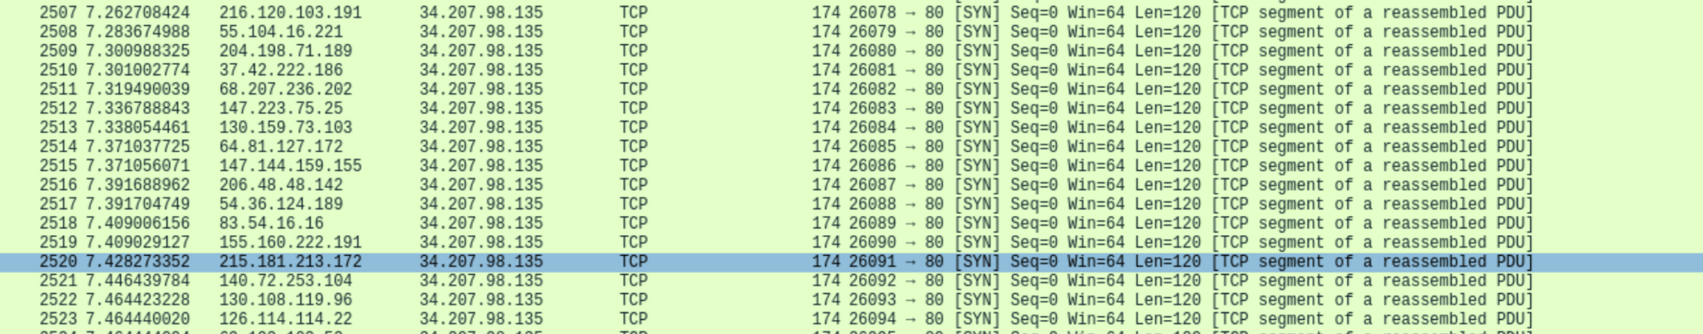
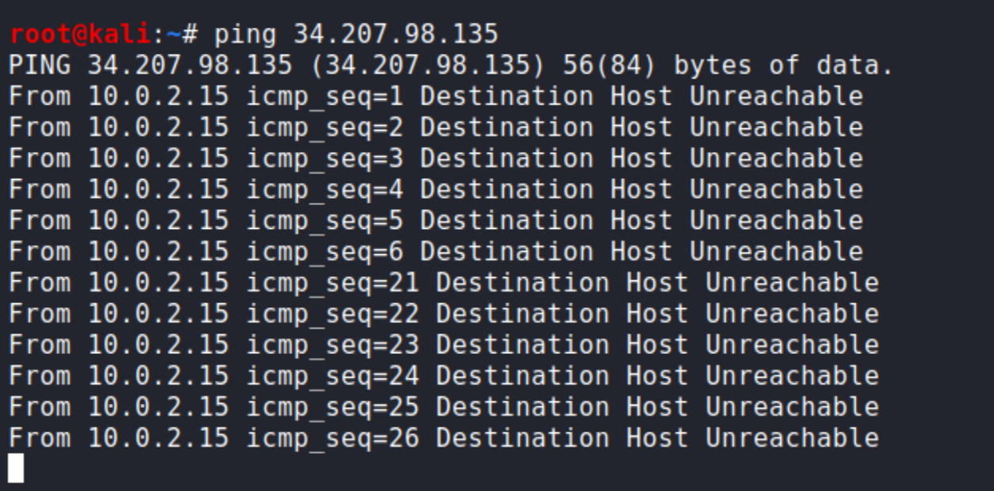
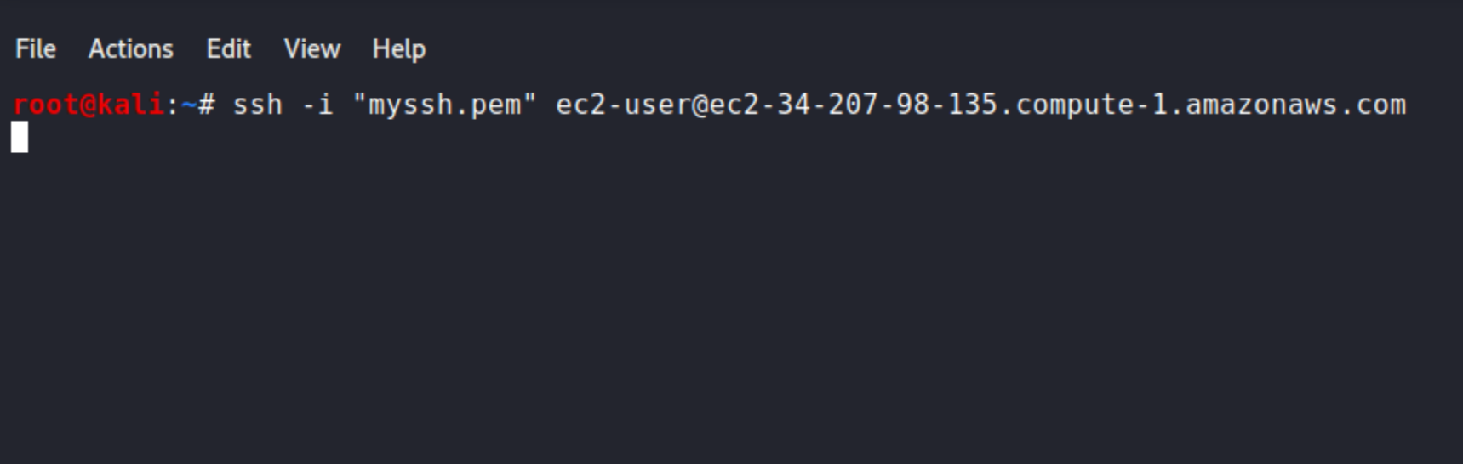
SYN Flood Attack Result
Notes:
Mahesh

Slide 32
Materials and Methods
Cloud security is a set of policies, controls, procedures and technologies that should work together to protect your cloud-based applications and systems.
Data Integrity and Protection
One of the biggest concerns which disinclined the trust and authenticity on the Cloud Infrastructures
One of the best ways to mitigate this threat is to secure your data using in-transit and at-rest data security.
This would include the use of encryption both for email server and for the messages themselves.
This would include the use of digital certificates such as SSL/TLS website certificates and S/MIME
Notes:
sapna

Slide 33
Materials and Methods (Continued...)
Lack of cloud security architecture and strategy
Keep threat models up to date.
Deploy continuous monitoring capability
Insufficient identity, credential, access and key management
Inadequately protected credentials
Lack of automated rotation of cryptographic keys, passwords and certificates
Lack of scalability
Failure to use multi-factor authentication
Failure to use strong passwords
Notes:
sapna

Slide 34
Materials and Methods ( Continued…)
Account hijacking
Don’t just do a password reset when account credentials are stolen. Address the root causes.
A defense-in-depth approach and strong IAM controls are the best defense.
Insider threats
Conduct employee training and education on proper practices to protect data and systems. Make education an ongoing process.
Regularly audit and fix misconfigured cloud servers.
Restrict access to critical systems
Insecure interfaces and APIs
Employ good API practices such as oversight of items like inventory, testing, auditing and abnormal activity protections.
Protect API keys and avoid reuse.
Consider an open API framework such as the Open Cloud Computing Interface (OCCI)
Notes:
sapna

Slide 35
Results of Cloud Infrastructure Network and the Infrastructure Security
Protection against DDoS
This entails monitoring, absorbing and dispersing DDoS attacks to minimize risk.
Data security
This prevents a third party from eavesdropping or tampering with data being transmitted.
Regulatory compliance
Helps in managing and maintaining enhanced infrastructures for compliance and to protect personal and financial data.
Flexibility
When the high traffic is over, you can scale back down to reduce costs.
High availability and support Live monitoring 24 hours a day, 7 days a week, and every day of the year.
Notes:
sapna

Slide 36
Things to do to prevent hacks and breaches
Companies should embrace automation and use technologies that continuously scan for misconfigured resources and remediate problems in real time.
Develop and implement a security architecture framework.
Ensure that the threat model is kept up to date.
Bring continuous visibility into the actual security posture.
Take measures to minimize insider negligence to mitigate the consequences of insider threats
Practice good API hygiene. This includes the diligent oversight of items such as inventory, testing, auditing, and abnormal activity protections.
All cloud providers should conduct penetration testing and provide findings to customers.
Notes:
sapna

Slide 37
Recommended Configurations to follow while using Infrastructure as Code:
Permissions to IaC User:
The deployment user/role should only have write-only access to cloud servers during the deployment for the application.
This will restrict the intruder from getting the secrets or user’s data from the server if it got access to the cloud infrastructure via IaC.
Path configuration:
it's important to save all paths in the config file and encrypt that file.
This will protect the file as well as saves time and effort in the case of any path issues.
So during the breach attempt, it will save time to reconfigure paths and make deployment available back again in less amount of time.
Notes:
Krutarth

Slide 38
Conclusion
Cloud Security is a layered architectural approach
Misconfigurations should be avoided at all cost.
Identifying the risk points in the architecture helps to identify the security solution
Security approach can be same as on premise but keep the infrastructure shift in mind while designing the cloud architecture
Notes:
sapna

Slide 39
Thank you!
Any Questions

